Slide 1



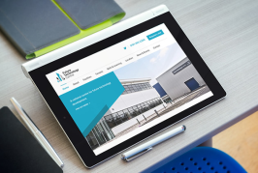



Technology Group
Management Update June 2018
Official Sensitive
Technology Group

Slide 2
Agenda
Target Operating Model
Pace Brand Plan Update
Progress Against TG Objectives
Q&A

Slide 3
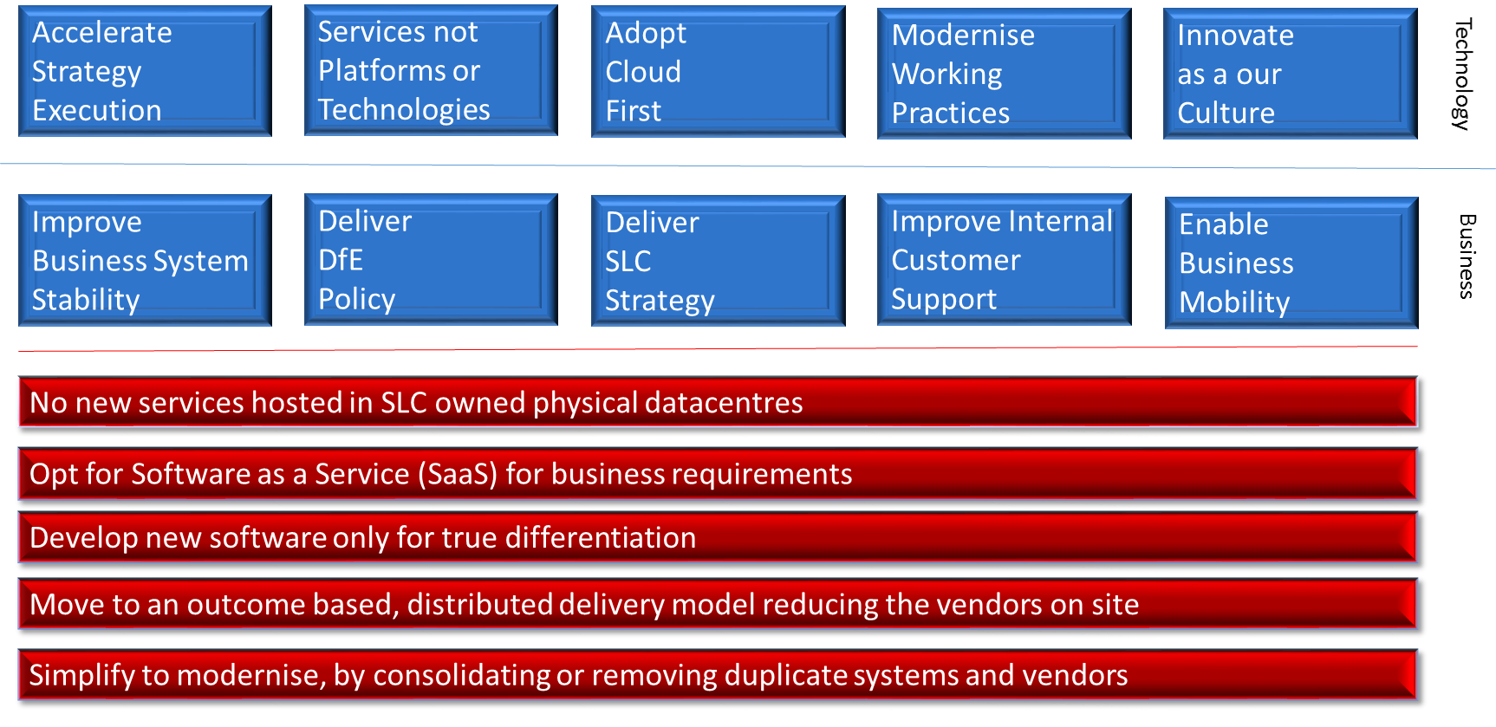
Strategy & Red Lines

Slide 4
Strategy Execution
Technology Strategy Programmes (SLC 2020 Strategy)
Innovation
To modernise the architecture, drive value from data and refresh our core platforms (CLASS, LA Portal)
Key Fact:
The new Technology strategy has been formed out of what was “Digital Architecture“ and the former “Technology Portfolio”
Stabilisation
To keep today’s services stable and compliant by taking opportunities to upgrade. Removing duplicate solutions
Cloud
To enable more responsive change and keep the operating environment secure. Demising SLC’s own data centres
Security
To secure SLC from external attacks, improve internal defences and minimise overall operational risks
Mobility
To enable a more productive, engaged and mobile team and facilitate news styles of collaborative working

Slide 5
Strategy Timeline
Jul - Dec 2018
Implement TOM to enable a Three Year Technology Strategy
Jul 2018 - Jun 2019
Year 1
Technology Strategy
Jul 2019 – Jun 2020
Year 2
Technology Strategy
Jul 2020 – Jun 2021
Year 3
Technology Strategy
Reset for next
Three year
Technology Strategy
Key Fact
It has been a slower start to getting the strategy work going than we had planned as resource implications were not considered well enough, we still may need to further “top slice” teams to work on strategy independent of ongoing dleivery

Slide 6
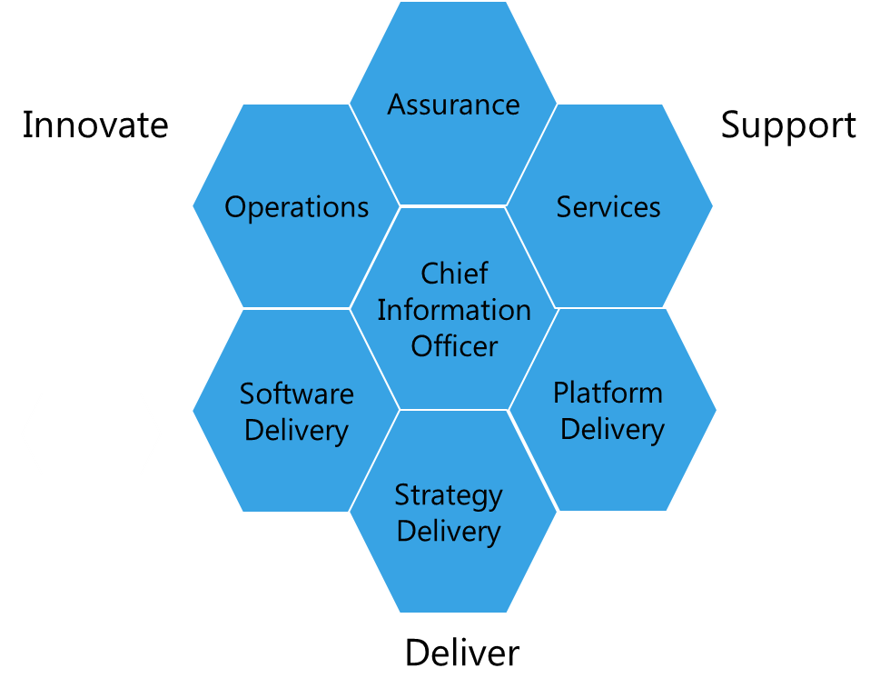
Senior Leadership Team
Operations
Services
Internal operations with emphasis on vendor relationships and internal change. Ensuring appropriate governance and financial disciplines.
Driving a culture of service excellence for Mobility, Operational and Data Centre Services governed by the Services Management team.
Delivery
Strategy - Execution of the Technology Strategy
Software - Unified and aligned to business service; namely Apply, Assess, Pay & Repay
Platform - Unified and aligned by shared capabilities, namely; Data, Security, Platform

Slide 7
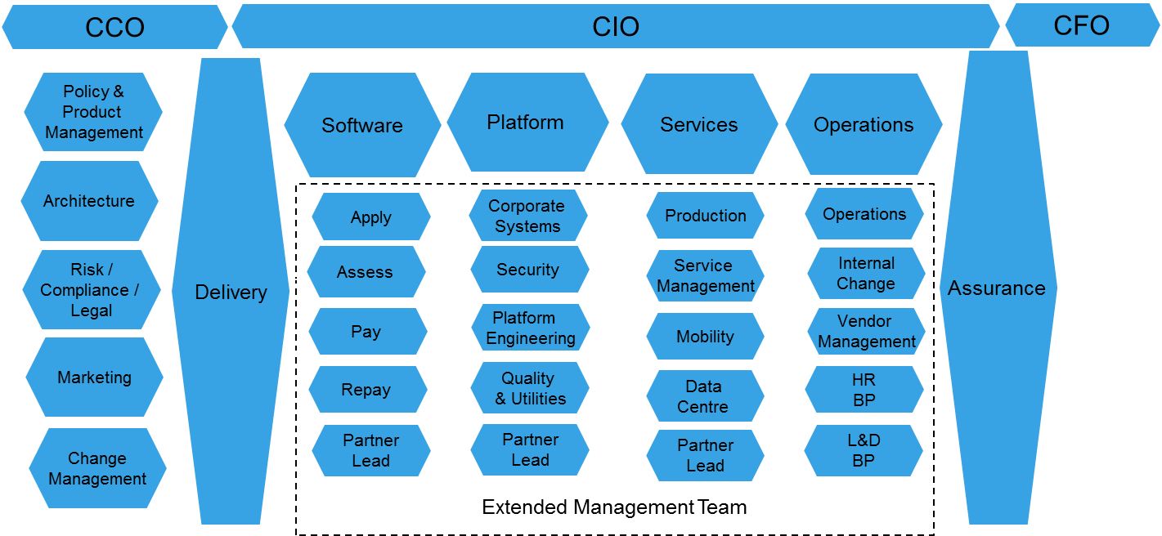
Extended Management Team
Functional Alignment
Share leadership load and empower an extended management team
Execute Technology Strategy, Policy Delivery and Production Services

Slide 8
FAQ’s
TOM - Target Operating Model. Implementation will start July 1st and proceed over next six months following standard HR processes
Calls for 30 plus key role changes. Creating opportunities at G6, G5 and G4 levels. All Proposed New Roles will we posted internally, so you have the opportunity to apply.
We will start with G6 layer, JD’s have been completed. Will empower the leaders appointed to refine the target structures that follow on next few slides
One aim is to reduce our requirement to use consultants (PDL roles), with Technology Group being about the higher skilled ’Core’ roles, working with our strategic vendors to get scale as needed
This is not about more managers but increased leadership bandwidth (G6 roles) to make the change we all know is needed and to help us all spend more time developing staff
We don’t believe any roles are put at risk by this, but remits will change and job matches will be done by HR to normal practice

Slide 9
Technology Group – Effective July 1st
CIO
Adrian Tucker
Architecture
Alex Ciambrone
Technology
Delivery
Nigel Carroll
Portfolio
Management
Elaine Whitefoot
Technology
Operations
Brian Morris
Technology
Services
Eddie O’Hara
Finance
Business Partner
Carol Ann Cox
Software
Delivery
Jon Hopkins
CISO &
Platform Delivery
Alun McGlinchey
Team
Admin
Cath Heywood (I)

Slide 10
Technology Operations – TOM proposal
Technology
Operations
Brian Morris
Vendor
Management
Existing Vacancy
Vendor Manager (Platform)
Existing Vacancy
Internal
Change
Proposed New Role
Internal
Change
G Kay
Operations
Management
Existing Vacancy
Demand &
Capacity Planning
M Shepherd
Digital
Operations
C Allison
Team
Admin
H Russell
L&D
Business Partner
Vacancy
Vendor Manager (Services)
Existing Vacancy
Vendor Manager (Software)
Existing Vacancy
Vendor Manager
J Dougan
Performance &
Controls
C Todd
Internal
Governance
L Hill
Internal
Communications
R Bonnar
Support
Analyst
L Boyd
Support
Analyst
Existing Vacancy
Skills
Management
Proposed New Role
HR
Business Partner
Lynda Hainan

Slide 11
Technology Software Delivery – TOM proposal
Technology
Delivery
Nigel Carroll
Software
Delivery
Jon Hopkins
Apply
Delivery
Proposed New Role
Assess
Delivery
Proposed New Role
Pay
Delivery
Marion Wilson
Repay
Delivery
Proposed New Role
Platform
Design lead
Proposed New Role
Apply
(CMS)
Proposed New Role
Apply
(CP)
I Ferguson
Platform
Design Lead
Proposed New Role
Platform
Design Lead
Existing Vacancy
Platform
Design Lead
Proposed New Role
Assess
(LA Portal)
K McGroarty (I)
Assess
(BCF)
M Relly
Assess
(Common)
I Davidson
Strategic
Delivery Lead
Vendor Role
Pay
(SIS & HEBSS)
S MacDougall
Pay
(CLASS Pay)
M Nelson
Repay
(Repay Portal)
D McMahon
Repay
(CLASS Repay)
M Stewart
Repay
(Tallyman)
Proposed New Role
Pay
(CLASS Lending)
M Marsh
Process
Improvement
Proposed New Role
Apply
(FE)
I Shafi
Team
Admin
C Scott

Slide 12
Technology Platform Delivery – TOM proposal
Technology Delivery
Nigel Carroll
CISO & Platform Delivery
Alun McGlinchy
Corporate
Systems
Tom Ballantyne
Quality
& Utilities
P Bruning (I)
Platform
Engineering
Proposed New Role
Security
Existing Vacancy
Platform
Design Lead
Existing Vacancy
Strategic
Delivery lead
Vendor role
Data
Analytics
E Webb
Inbound / Outbound
Correspondence
S McKibbin
ERP
Proposed New Role
Environments &
Testing Services
C Hamilton
Release
Testing
R Watson
Integration
& Utilities
Proposed New Role
Platform
Design Lead
Proposed New Role
Core
Tools
Proposed New Role
Threat &
Vulnerability
K Jordan
Identity & Access
Management
Existing Vacancy
Platform
Design Lead
Proposed New Role
UNIX
D Waddell
DevOps
Proposed New Role
Database
Administration
G Melin
Data
Quality
D Garbutt
Consulting &
Governance
R Kennedy
Team
Admin
Existing Vacancy
Darlington
CI
J McNamee
Process
Improvement
Existing Vacancy

Slide 13
Technology Services – TOM proposal
Technology Services
Eddie O’Hara
Mobility
Services
Proposed New Role
Infrastructure
Design Lead
Proposed New Role
Service
Management
A Robertson
Change
Management
Proposed New Role
Production
Services
Existing Vacancy
Infrastructure
Design Lead
Proposed New Role
Data Centre
Services
A Hastings (C)
Servers &
Virtualisation
Proposed New Role
Capacity &
Storage & Backup
Proposed New Role
Network
Operations Centre
C McFadden
Disaster
Recovery
I Gegan
Team
Admin
P Walker
Printing &
Intranet
Proposed New Role
Strategic
Delivery Lead
Vendor Role
Messaging &
Collaboration
I F Scott
Desktop
Services
S Butt
Problem Mgt
FLS
K Docherty
Telecoms
& CCT
Proposed New Role
Cloud
Operations
Proposed New Role
Networks
C Nelson
Incident Mgt.
(incl. Service Desk)
Existing Role
Service Manager
(TBC - CCO, HR, Apply)
Proposed New Role
Service Manager
(TBC - Operations, Assess,Pay)
Proposed New Role
Service Manager
(TBC - Finance & Repayments)
Proposed New Role
Systems
Management
Proposed New Role
Process
Improvement
Proposed New Role

Slide 14
PBP Update

Slide 15

PBP – Your programme for change
Main areas of focus since launch
1. PACE
Small process change and set up collaborative working groups
GovWiFi availability and working area refurbishments
Simplifying request processes and delegated approvals
Team training (security, services)
Many feedback items folded into programmes, esp Mobility, ROTM
2. BRAND
TG branded materials, templates etc and events delivered
Other initiatives eg Induction, Employee engagement, LB4UW, Recruitment fair, strategic programme branding
3. PLAN
Getting to today.
Good work done to date but…
Delivering @ PACE
Continue to identify blockers & simplify processes at individual and team level
Teams to take the initiative
Developing the BRAND
More communication and celebration
Act on self empowerment and self determination
Executing the PLAN
Must deliver what we agree on TOM and in the strategic programmes
Total
281
Backlog
66
Doing
67
Done
148
+ 7
 |  | Pace | Brand | Plan
Backlog | 66 | 32 | 13 | 22
Doing | 67 | 30 | 29 | 8
Done | 148 | 84 | 53 | 11

Slide 16
PBP - Latest survey feedback
If they could fix one thing now the themes include:
· Understanding how they can get involved
· Breaking down barriers between teams and moving to a more agile way of working.
· More resources
· People too busy to fix things causing pain and a decreased focus on PBP
· Demonstrating what’s best for our customer
· Clear and consistent way forward
4 – If yes please say what you were involved in (examples):
Townhall attendance, getting involved in the new induction initiative, championing the brand and implementing improvements to our systems

Slide 17




PBP - Brand Update
Training
Consolidated training requirements reviewed
Planning for priority training has started
Sourcing training providers through L&D and Technology Operations
Sourcing more online CBT training through Pluralsight
Staff Induction
New TG Induction launching in July
New TG Induction pack created
Complements the SLC induction and supports the ‘One Team’ culture across Technology Group and SLC
Employee Survey Working Group
Staff engagement Working Group mobilised
Priority areas are:
Opportunities to personally develop
Commitment to personal growth
Commitment to continually improve
Regular praise for doing good work
List of recommendations being progressed
Creating a new Personal Development Plan document
Re-establishing Best Practice Forums
Improving visibility of all learning options available within SLC to support development
Technology Group – Communications
Communications Manager Rosaleen Bonnar supporting branding and communications across TG
Notes:
Induction:
Complimenting the SLC induction and supporting the One Team culture across Technology Group
Technology Group Induction sessions to introduce new starts to all the teams in TG – launching July
New Technology Group Induction pack including
Technology Group Welcome Pack
Guidance for Line Managers
Technology Group Team descriptors
Common SLC Acronym List published
Team Overview – brief introduction to all TG teams
Employee Engagement Working group:
Cross-directorate working group representative of all levels of TG – approx. 17 people involved

Slide 18

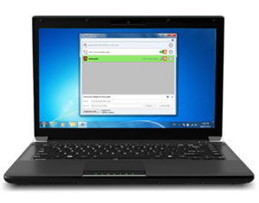
PBP - Pace Update
Current Priorities
Delegated Equipment Request Policy
Firewall Rule simplification
Improvements in SAR process

Slide 19
TG Objectives Update

Slide 20
Objectives Update – End of the first quarter
Strategic
Delivery
Update the Technology strategy for next 18 months to reflect changing technologies
Deliver APRA including key policy ask for SFE, SFW and SFNI
Socialise and enforce the technology “redlines” to drive the strategy and direction
Deliver Office 365/New Device/Wi-Fi (Mobility) – Subject to budget
Implement new Target Operating Model for the directorate (implementation throughout 2018/9)
Create elective continuous improvement programme
Create a Technology Group Succession plan by September 2018
Create Innovation Sandbox environments to test and try new technologies
Develop Technology apprenticeship programme to create a more targeted mentoring and career progression approach (By September 2018)
Create new Security Operating Centre (SOC)
Close and decommission Bothwell Street and Hillington “old” datacentres as part of cloud strategy (by December 2018)
Vendor Base
Improve Supplier Value for Money and delivery methodology
Identify Cloud ready applications and start migration to cloud (Ongoing 18/19)

Slide 21
Q&A – Let’s chat!

